Slide 1


Slide 2
Hashing Technique
Suppose we want to design a system for storing employee records keyed using phone numbers. And we want following queries to be performed efficiently:
Insert a phone number and corresponding information.
Search a phone number and fetch the information.
Delete a phone number and related information.

Slide 3
Hashing Technique
We can think of using the following data structures to maintain information about different phone numbers.
Array of phone numbers and records.
Linked List of phone numbers and records.
Balanced binary search tree with phone numbers as keys.
Direct Access Table.

Slide 4
Hashing Technique
For arrays and linked lists, we need to search in a linear fashion, which can be costly in practice. If we use arrays and keep the data sorted, then a phone number can be searched in O(logn) time using Binary Search, but insert and delete operations become costly as we have to maintain sorted order.
With balanced binary search tree, we get moderate search, insert and delete times. All of these operations can be guaranteed to be in O(logn) time.

Slide 5
Hashing Technique
Another solution that one can think of is to use a direct access table where we make a big array and use phone numbers as index in the array. An entry in array is NIL if phone number is not present, else the array entry stores pointer to records corresponding to phone number. Time complexity wise this solution is the best among all, we can do all operations in O(1) time. For example to insert a phone number, we create a record with details of given phone number, use phone number as index and store the pointer to the created record in table.

Slide 6
Hashing Technique
This solution has many practical limitations.
Space Requirement is huge.
For example if phone number is n digits, we need O(m * 9^{n}) space for table where m is size of a pointer to record.
2. Another problem is an integer in a programming language may not store n digits.
Due to above limitations Direct Access Table cannot always be used. Hashing is the solution that can be used in almost all such situations and performs extremely well compared to above data structures like Array, Linked List, Balanced BST in practice. With hashing we get O(1) search time on average (under reasonable assumptions) and O(n) in worst case.

Slide 7
Hashing Technique
Hashing is an improvement over Direct Access Table. The idea is to use hash function that converts a given phone number or any other key to a smaller number and uses the small number as index in a table called hash table.

Slide 8

Hashing Technique
In general, in all searching techniques, search time is dependent on the number of items. Sequential search, binary search and all the search trees are totally dependent on number of items and many key
comparisons are involved.
Hashing is a technique where search time is independent of the number of items or elements. In this technique a hash function is used to generate an address from a key. The hash function takes a key as input and returns the hash value of that key which is used as
an address index in the array.

Slide 9
Hashing Technique
We can write hash function as follows
h(k) = a;
Where h is hash function, k is the key, a is the hash value of the key.
While choosing a hash function we should consider some important points.
- It should be easy to compute
- It should generate address with minimum collision.

Slide 10
Hash Function
A mapping function that maps a key to a number in the range 0 to TableSize-1
int hashfunc(int integer_key)
{
return integer_key% HASHTABLESIZE;
}

Slide 11
Different Techniques for making Hash Function
Techniques for making hash function.
- Truncation Method
- Midsquare Method
- Folding Method
- Division Method

Slide 12
Truncation Method
This is the simplest method for computing address from a key. In this method we take only a part of the key as address.
Example:
Let us take some 8 digit keys and find addresses for them. Let the table size is 100 and we have to take 2 rightmost digits for getting the hash table address. Suppose the keys are.
62394572, 87135565, 93457271, 45393225.
So the address of above keys will be 72, 65, 71 and 25 respectively.
This method is easy to compute but chances of collision are more because last two digits can be same in more than one keys.

Slide 13
MidSquare Method
In this method the key is squared and some digits from the middle of this square are taken as address.
Example:
Suppose that table size is 1000 and keys are as follows
Key | 1123 | 2273 | 3139 | 3045
Square of key | 1261129 | 5166529 | 9853321 | 9272025
Address | 611 | 665 | 533 | 720

Slide 14
Folding Method
In this technique the key is divided into different part where the length of each part is same as that of the required address, except possibly the last part.
Example:
Let key is 123945234 and the table size is 1000 then we will break this key as follows
123945234 ----> 123 945 234
Now we will add these broken parts. 123+945+234=1302. The sum is 1302, we will ignore the final carry 1, so the address for the key 123945234 is 302.

Slide 15
Division Method (Modulo-Division)
In Modulo-Division method the key is divided by the table size and the remainder is taken as the address of the hash table.
Let the table size is n then
H (k) = k mod n

Slide 16
Example
Let the keys are 123, 945,234 and table size is 11 then the address of these keys will be.
123 % 11=2
945%11=10
235%11=4
So the hash address of above keys will be 2,10,4.

Slide 17
Collision Handling
Since a hash function gets us a small number for a key which is a big integer or string, there is possibility that two keys result in same value. The situation where a newly inserted key maps to an already occupied slot in hash table is called collision and must be handled using some collision handling technique.

Slide 18
Following are the ways to handle collisions:
1. Chaining/Separate Chaining/Open Hashing: The idea is to make each cell of hash table point to a linked list of records that have same hash value. Chaining is simple, but requires additional memory outside the table.
2. Open Addressing/Closed Hashing: In open addressing, all elements are stored in the hash table itself. Each table entry contains either a record or NIL. When searching for an element, we one by one examine table slots until the desired element is found or it is clear that the element is not in the table.

Slide 19
Separate Chaining
The idea is to make each cell of hash table point to a linked list of records that have same hash function value.
Let us consider a simple hash function as “key mod 7” and sequence of keys as 50, 700, 76, 85, 92, 73, 101.

Slide 20
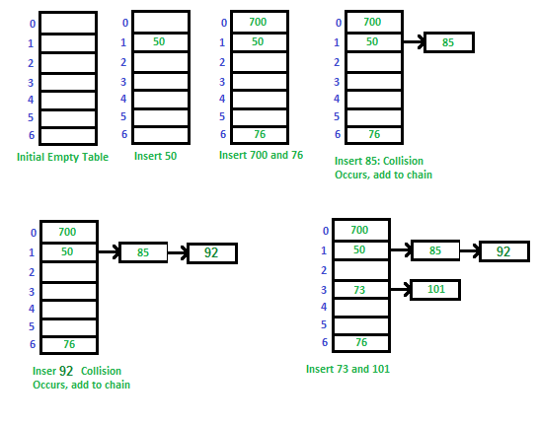

Slide 21
Advantages:
1) Simple to implement.
2) Hash table never fills up, we can always add more elements to chain.
3) Less sensitive to the hash function.
4) It is mostly used when it is unknown how many and how frequently keys may be inserted or deleted.
Disadvantages:
1) Cache performance of chaining is not good as keys are stored using linked list. Open addressing provides better cache performance as everything is stored in same table.
2) Wastage of Space (Some Parts of hash table are never used)
3) If the chain becomes long, then search time can become O(n) in worst case.
4) Uses extra space for links.

Slide 22
Performance of Chaining:
Performance of hashing can be evaluated under the assumption that each key is equally likely to be hashed to any slot of table (simple uniform hashing).
m = Number of slots in hash table
n = Number of keys to be inserted in hash table
Load factor α = n/m
Expected time to search = O(1 + α)
Expected time to insert/delete = O(1 + α)
Time complexity of search, insert and delete is O(1) if α is O(1)

